Slide 1

Multicore CPU Process Scheduling Simulator
Name: KALAISELVI Y Register Number: 2025620026 Department: Computer Science and Engineering(AI and ML)

Slide 2
Outline
Introduction
Problem Statement
Literature Survey
Existing System
Limitations of Existing System
Research Gap
Objectives
Proposed System
Modules
High Level Architecture Diagram
High-Level Flow
Tools & Platform
Expected Output
12-Week Project Plan
Applications
References

Slide 3
Introduction
CPU scheduling is an important function of an operating system.
It decides which process gets CPU execution.
Modern computers use multicore processors.
Multiple processes run simultaneously.
Scheduling occurs internally and is not visible to users or students.
Difficult to understand process allocation and execution.
A simulator is required to visualize and learn CPU scheduling.
The simulator also stores execution results in CSV files and applies Machine Learning analysis to study performance and predict efficient scheduling behavior.

Slide 4
Problem Statement
Modern computers use multicore processors.
Students find it difficult to understand scheduling across multiple cores.
OS schedulers run in the background.
Scheduling process cannot be visualized.
The project develops a simulator for demonstration.
Shows how different scheduling algorithms distribute processes to cores.
Helps analyze performance metrics.
Displays waiting time, turnaround time, and CPU utilization.
Execution results are stored in CSV files and Machine Learning analysis is used to study and compare scheduling performance.

Slide 5
REF [1] TITLE: Performance Evaluation of Dynamic Round Robin Algorithms for CPU Scheduling
AUTHORS: A. A. Alsulami, Q. A. Al-Haija, M. I. Thanoon, Q. Mao
CONFERENCE: IEEE SoutheastCon
YEAR: 2019
SUMMARY / ALGORITHM:
  This paper evaluates different variations of the Round Robin scheduling algorithm. The study mainly focuses on improving time quantum selection to reduce waiting time and turnaround time.
  Experimental results show that dynamic time quantum performs better than traditional Round Robin. However, the work is limited to algorithm performance analysis and does not provide visualization or multicore execution.

Slide 6
REF [2] TITLE: Simulation of CPU Scheduling Algorithms for Efficient Execution of Processes
AUTHORS: K. Vayadande, P. Sheth, D. Pawal, A. Pathak, K. Paralkar, S. Patil
CONFERENCE: International Conference for Advancement in Technology (ICONAT)
YEAR: 2023
SUMMARY / ALGORITHM:
  This paper presents a simulator to study CPU scheduling algorithms such as FCFS, SJF, Priority, and Round Robin.
  The simulator calculates performance metrics including waiting time and turnaround time for processes.
  The study helps in comparing algorithms but mainly considers a single-processor environment and lacks multicore visualization.

Slide 7
REF [3] TITLE: Comparative Analysis of Scheduling Algorithms for Grid Computing
AUTHORS: S. Sharma, A. Chhabra, S. Sharma
CONFERENCE: International Conference on Advances in Computing, Communications and Informatics (ICACCI)
YEAR: 2015
SUMMARY / ALGORITHM:
  The paper analyzes scheduling algorithms in distributed grid computing environments. It compares algorithms based on execution time and system performance.
  The research shows the importance of proper scheduling in resource allocation but does not focus on operating system level CPU scheduling learning or visualization tools.

Slide 8
REF [4] TITLE: E2C Simulator for Heterogeneous Systems
AUTHORS: Research group on computer architecture education
CONFERENCE: Computer Architecture and Education Research
YEAR: 2021
ALGORITHM / SUMMARY:
  This paper introduces an educational simulator (E2C) designed to teach scheduling concepts in heterogeneous and parallel systems. It demonstrates how different processors affect execution performance and helps learners understand parallel execution.
  The simulator is complex for beginners and not focused on simple operating system scheduling. Multicore Gantt chart visualization and easy algorithm comparison are not clearly provided.

Slide 9
REF [5] TITLE: Visualization Tools for Operating System Learning
AUTHORS: OS education researchers
JOURNAL: Interactive Learning Technologies
YEAR: 2022
ALGORITHM / SUMMARY:
  The study highlights the importance of visualization tools in teaching operating system concepts. It shows that graphical demonstrations improve student understanding of process execution and scheduling behavior.
  Existing tools lack multicore execution visualization and do not allow easy comparison of multiple scheduling algorithms with performance metrics.

Slide 10
REF [6] TITLE: CPU Scheduling Algorithms: Case & Comparative Study
AUTHORS: S. Zouaoui, L. Boussaid, A. Mtibaa
CONFERENCE: International Conference on Automatic Control and Computer Engineering (STA)
YEAR: 2016
ALGORITHM / SUMMARY:
  This study compares major CPU scheduling algorithms such as FCFS, SJF, Priority, and Round Robin. The performance is analyzed using metrics like waiting time and turnaround time.
  The work provides theoretical comparison but lacks implementation-based teaching support and real-time graphical execution.

Slide 11
REF [7] TITLE: Comparative Analysis of CPU Scheduling Algorithms &Their Optimal Solutions
AUTHORS: M. Rajasekhar Reddy, V. V. D. S. S. Ganesh
YEAR: 2019 (IEEE ICCCMC)
ALGORITHM / SUMMARY :
  The paper presents a comparative study of various CPU scheduling algorithms such as FCFS, SJF, SRTF, Round Robin and Feedback scheduling.
  It explains scheduling concepts including preemptive and non-preemptive scheduling and evaluates performance using parameters like waiting time, turnaround time and response time. The study also proposes modified versions of some algorithms to improve performance.
  The work is mainly theoretical and analytical. It does not provide an interactive simulation tool, real-time execution visualization or multicore CPU scheduling support.

Slide 12
EXISTING SYSTEM
Several CPU scheduling simulators are already available.
They implement traditional algorithms such as FCFS, SJF, Round Robin and Priority.
The simulators evaluate performance metrics like waiting time and turnaround time.
Execution is modeled using a single processor environment.
Mainly designed for theoretical understanding of operating system concepts.

Slide 13
Limitations of Existing System
Designed for single-core CPU architecture only.
Cannot simulate parallel execution of processes.
No visualization of process allocation across different CPU cores.
Unable to analyze core-wise CPU utilization.
Limited support for comparative analysis of algorithms in modern systems.
Not suitable for understanding real multicore processor behavior.
Students cannot clearly observe how scheduling works in practical systems.
Execution results are not stored as datasets (CSV).
No Machine Learning analysis or prediction of performance.

Slide 14
Research Gap
Existing simulators focus mainly on single-core processors.
Mostly theoretical analysis only.
No visualization of process distribution across multiple cores.
Cannot clearly observe multicore execution.
No proper educational tool for learning.
Difficult to compare multiple scheduling algorithms.
Performance metrics cannot be viewed in real time.
Therefore, a multicore scheduling simulator with visualization and performance comparison is proposed.
Existing simulators lack multicore visualization and do not use dataset-based (CSV) Machine Learning analysis to evaluate and predict scheduling performance.

Slide 15
Objectives
Simulate process scheduling in a multicore environment.
Implement different scheduling algorithms:
  FCFS
  SJF
  Round Robin
  Priority Scheduling
Show how processes are assigned to different CPU cores.
Calculate performance metrics:
  Waiting Time
  Turnaround Time
  Response Time
  CPU Utilization
Provide a visual interface for better learning.
To store execution results in CSV dataset files.
To apply Machine Learning analysis for performance comparison and prediction.

Slide 16
Proposed System
User enters process details.
Selects number of CPU cores (2 or 4).
Chooses scheduling algorithm.
System allocates processes to selected cores.
Processes are executed in the simulator.
Gantt chart is displayed after execution.
Performance metrics are calculated.
Metrics include waiting time, turnaround time, and CPU utilization.
The system stores scheduling results in CSV files and performs Machine Learning analysis to evaluate and predict scheduling performance.

Slide 17
High-Level Flow
User selects number of CPU cores.
User enters process details.
User chooses scheduling algorithm.
System assigns processes to cores.
Execution simulated step-by-step.
Gantt chart generated.
Performance metrics displayed.
Save results to CSV.
ML analysis for performance evaluation and prediction.

Slide 18
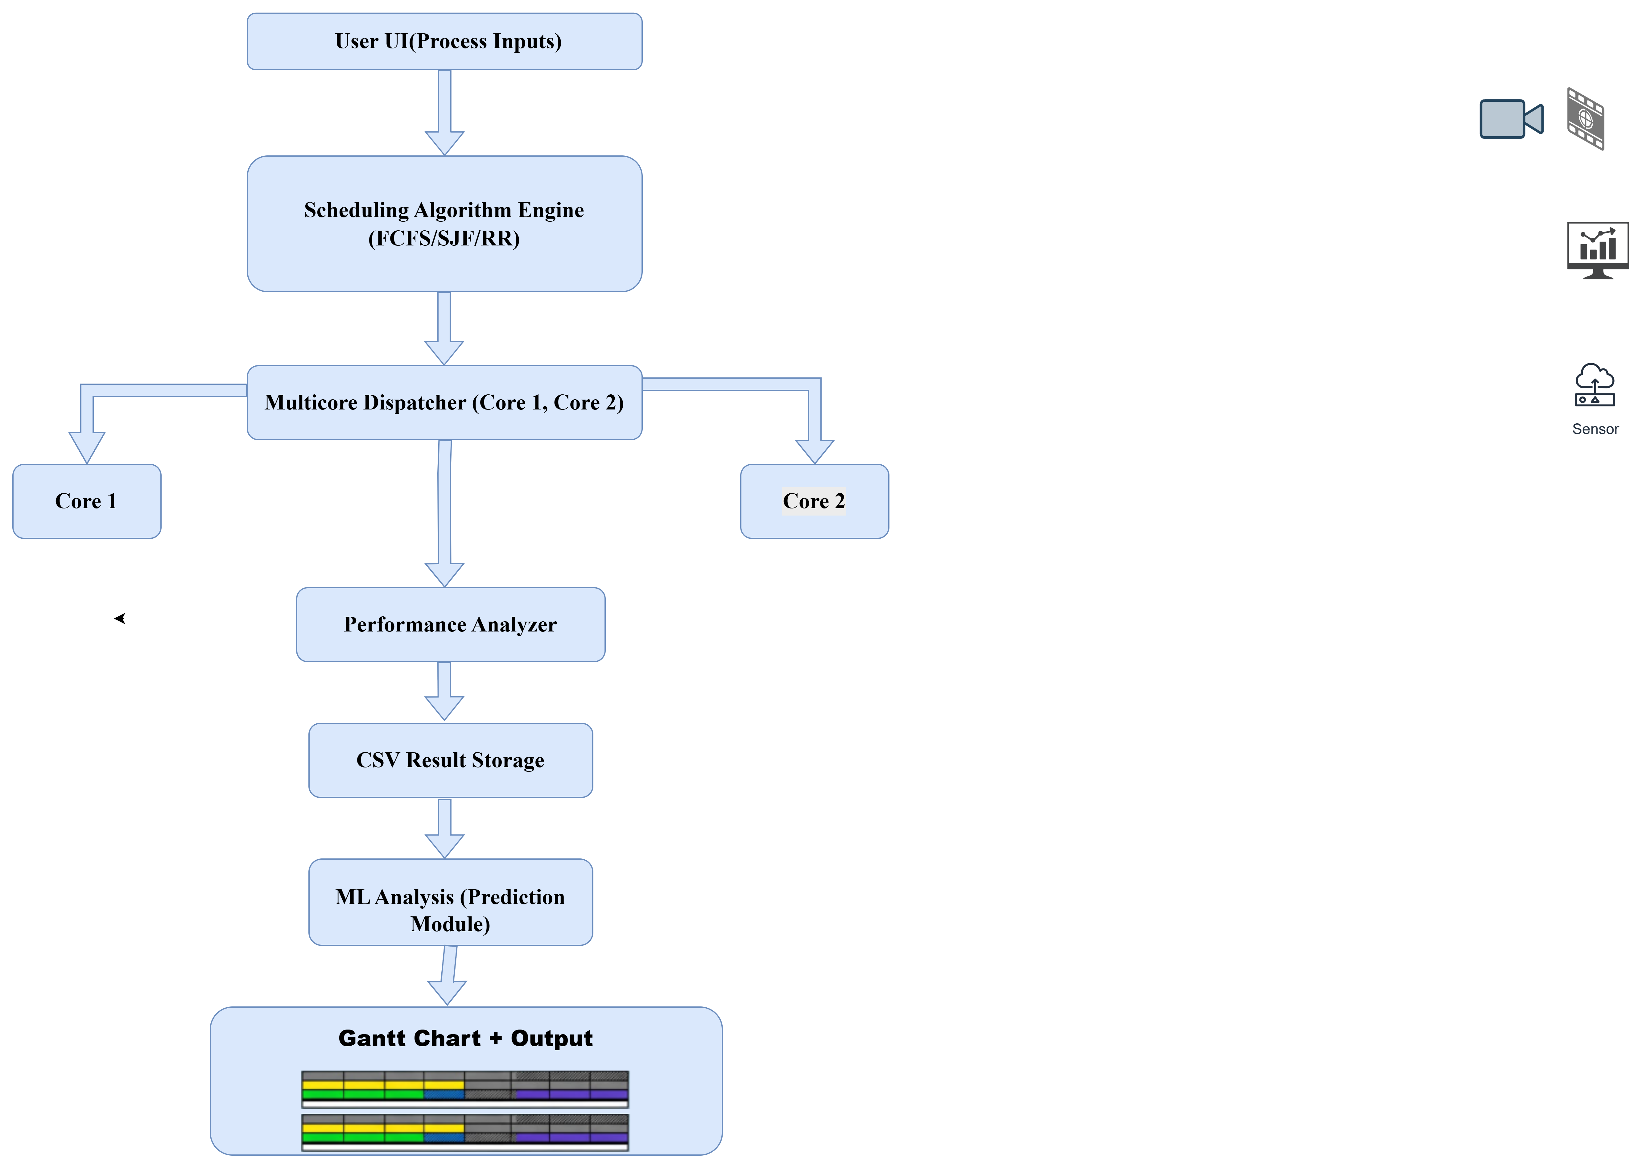
High-Level Architectural Diagram

Slide 19
Methodology
User enters process details.
Selects scheduling algorithm.
Processes are allocated to available CPU cores.
Simulation is executed.
Gantt chart is generated to visualize execution.
Performance metrics are calculated.
Metrics include waiting time, turnaround time, and CPU utilization.
Execution results are stored in a CSV dataset file.
The ML analysis module applies Machine Learning to analyze and predict performance.

Slide 20
Modules
Module 1: Process Creation Module
User enters:
  Process ID
  Arrival Time
  Burst Time
  Priority
Module 2: Multicore Scheduler
Simulates 2 or 4 CPU cores.
Assigns processes to cores based on selected scheduling algorithm.

Slide 21
Modules
Module 3: Scheduling Algorithms Engine
Implements:
  FCFS
  SJF (Non-preemptive)
  Round Robin (with time quantum)
  Priority Scheduling
Module 4: Performance Calculator
Computes:
  Average Waiting Time
  Average Turnaround Time
  Throughput
  CPU Utilization
Module 5:Visualization
Gantt Chart for each core.
Process execution timeline.
Module 6: CSV Storage
Saves execution results as a dataset in a CSV file.
Module 7: ML Analysis
Analyzes scheduling performance and provides prediction

Slide 22
Tools & Platform
Category | Tool | Purpose in Project
Programming Language | Python | Core logic implementation
GUI | Tkinter | User interface for input & visualization
Scheduling Logic | Python Data Structures | Queue, Lists for process scheduling
Data Storage | CSV | Store results dataset
Data Processing | Pandas | Handle scheduling data
Machine Learning | Scikit-learn | Performance analysis & prediction
Visualization | Matplotlib | Gantt chart display for CPU cores
Development Environment | VS Code | Coding and debugging
Platform | Windows | Running the simulator

Slide 23
Expected Output
Provides multicore execution visualization.
Displays Gantt chart for each CPU core.
Calculates waiting time.
Calculates turnaround time.
Calculates CPU utilization.
Enables comparison of different scheduling algorithms.
Helps analyze algorithm performance effectively.
Automatic saving of execution results in CSV dataset files.
Machine Learning analysis showing performance evaluation and prediction of scheduling behavior.

Slide 24
12-Week Project Plan
Week 1–2: Topic selection, guide discussion, and research paper collection.
Week 3–4: Literature survey, research gap and problem statement identification.
Week 5–6: System design, architecture diagram, and tool selection (Python, Tkinter, Matplotlib).
Week 7–8: GUI development and implementation of FCFS, SJF, Priority & Round Robin algorithms.
Week 9: Multicore process allocation and performance metrics calculation (WT, TAT, CPU Utilization).
Week 10:CSV result storage and ML analysis module implementation.
Week 11: Gantt chart generation and execution visualization.
Week 12: Testing, debugging, documentation, and final presentation preparation.

Slide 25
Applications
Used for operating system education.
Helps students understand CPU scheduling practically.
Useful as a learning and teaching tool in laboratories.
Helps in algorithm analysis.
Enables performance comparison of scheduling algorithms.
Dataset generation using CSV files for analysis.
Machine Learning based study and prediction of scheduling performance.

Slide 26
References
A. A. Alsulami, Q. A. Al-Haija, M. I. Thanoon and Q. Mao, "Performance Evaluation of Dynamic Round Robin Algorithms for CPU Scheduling," 2019 SoutheastCon, Huntsville, AL, USA, 2019, pp. 1-5.
K. Vayadande, P. Sheth, D. Pawal, A. Pathak, K. Paralkar and S. Patil, "Simulation of CPU Scheduling Algorithms for Efficient Execution of Processes," 2023 International Conference for Advancement in Technology (ICONAT), Goa, India, 2023, pp. 1-6.
S. Sharma, A. Chhabra and S. Sharma, "Comparative analysis of scheduling algorithms for grid computing," 2015 International Conference on Advances in Computing, Communications and Informatics (ICACCI), Kochi, India, 2015, pp. 349-354.
S. Zouaoui, L. Boussaid and A. Mtibaa, "CPU scheduling algorithms: Case & comparative study," 2016 17th International Conference on Sciences and Techniques of Automatic Control and Computer Engineering (STA), Sousse, Tunisia, 2016, pp. 158-164.

Slide 27
References
Educational Computer Architecture Research Group, “E2C: A Simulator for Heterogeneous and Parallel Systems, Computer Architecture and Education Research”, 2021.
Operating Systems Education Researchers, “Visualization Tools for Operating System Learning”, Interactive Learning Technologies Journal, 2022.
M. Rajasekhar Reddy, V. V. D. S. S. Ganesh, S. Lakshmi and Y. Sireesha, “Comparative Analysis of CPU Scheduling Algorithms and Their Optimal Solutions,” IEEE International Conference on Communication, Computing and Machine Learning (ICCCML/ICCCMC), 2019.

